Slide 1

Memo Logger
- Doug Penner
- Eddie Zhang
- Kyle Macdonald
- Max Wardell
- Steffen Norgren

Slide 2
The program
Create memos.
Take snapshots.
Record sound.
Access memo from home.
Easy to use.

Slide 3
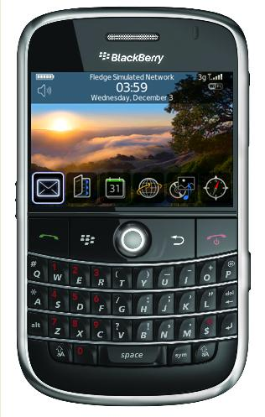
The Device
Track wheel
Camera
Microphone
Speakers
- Keys

Slide 4
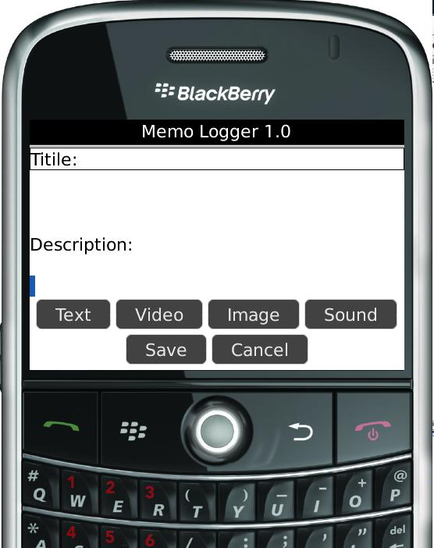
The GUI
Title:
Listbox:
Description:
Function Buttons:

Slide 5
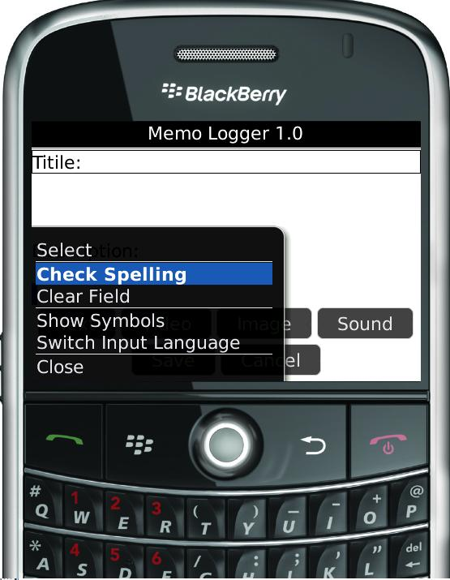
The GUI cont.
GUI Functionalities
GUI in the future:
  Background
  Word shortcuts

Slide 6
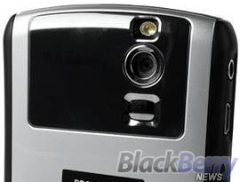
Camera
The Player
Snapshots
Viewfinder
Data Storing

Slide 7
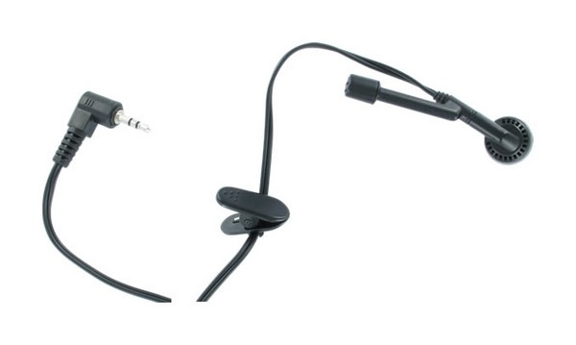
Microphone
The Player
Recording
Playback
Data Storing
Timer
Gauge Bar

Slide 8
Sending Data
Data sent to server.
Data transferred in XML format.
Sound/Video attached as SOAP messages.
Stored in a data base / file system.
Session IDs for authentication.

Slide 9
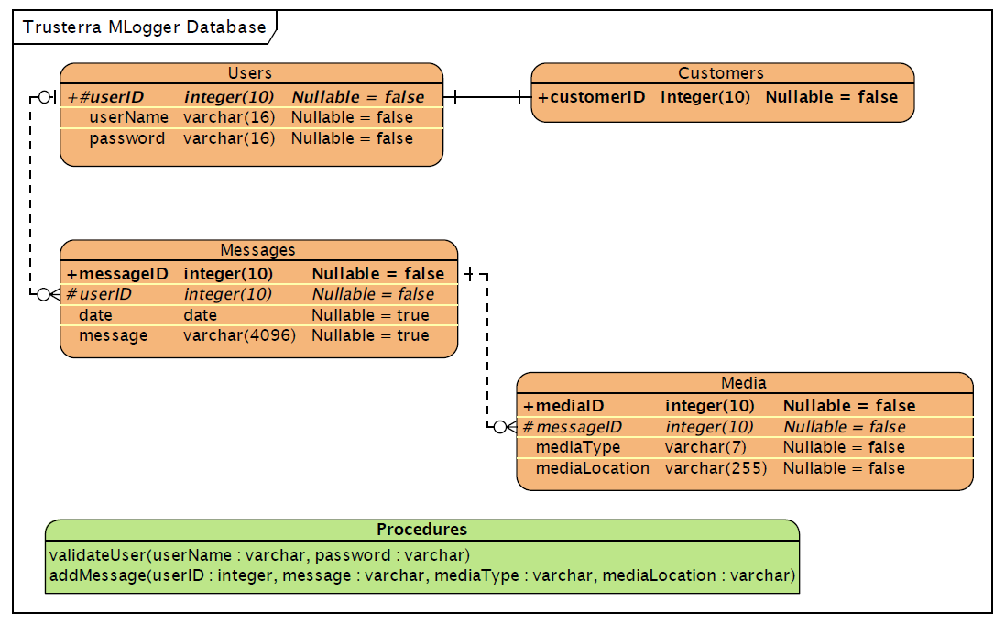

Slide 10
Media Controller
Acquiring new media
Organizing and Managing existing media
Generating XML messages
Generating statistics for GUI

Slide 11
Challenges
Time management
Documentation
Learning new tools (server)
Learning new API
Procrastination
Contract Issues
Indecision on target platform
Communication lag time
Scheduling conflicts

